Slide 1

Air Quality
Age 11-14 (UK Key Stage 3)

Slide 2

Why do we need clean air?

Slide 3


Air pollution can
Damage your lungs and stop them growing properly
Make asthma and other lung problems worse

Slide 4
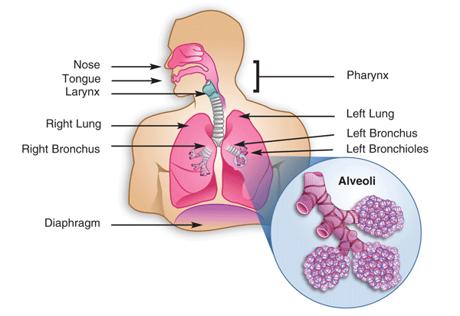


How the lungs work
Watch an animation of how the lungs work https://www.youtube.com/watch?v=f_xnopMf3p8

Slide 5

How air pollution affects the lungs
Pollutants can irritate the lungs or get stuck
Breath in pollutants as well as oxygen

Slide 6
How air pollution affects the lungs
Pollution can cause immediate problems like coughing and wheezing
Air pollution inhibits the rapid lung development normally seen between ages 10 and 18.
It can also cause long-term damage like cancer

Slide 7
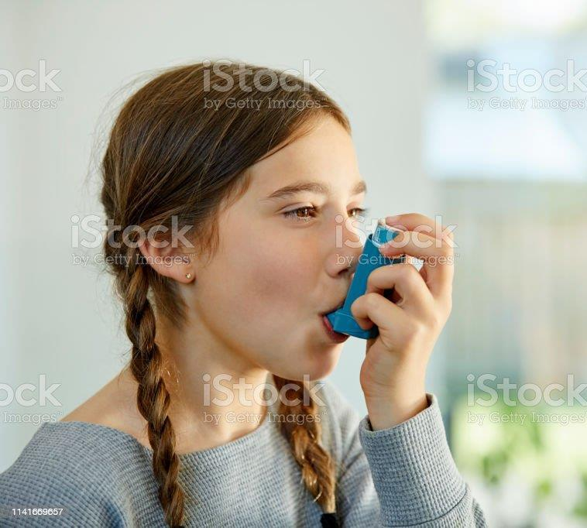
Asthma and COPD
Asthma and COPD are lung conditions that can make it hard to breathe
Air pollution can make asthma and COPD worse
Asthma is often inherited (genetic)
COPD is mainly caused by smoking
Do you or anyone you know have asthma or COPD?

Slide 8
Why asthma makes it hard to breathe
Try breathing through a straw to see what it feels like to have asthma
Healthy airways are relaxed and open so air can flow easily
With asthma the airways get swollen, making it hard to breathe
Air pollution can cause this

Slide 9
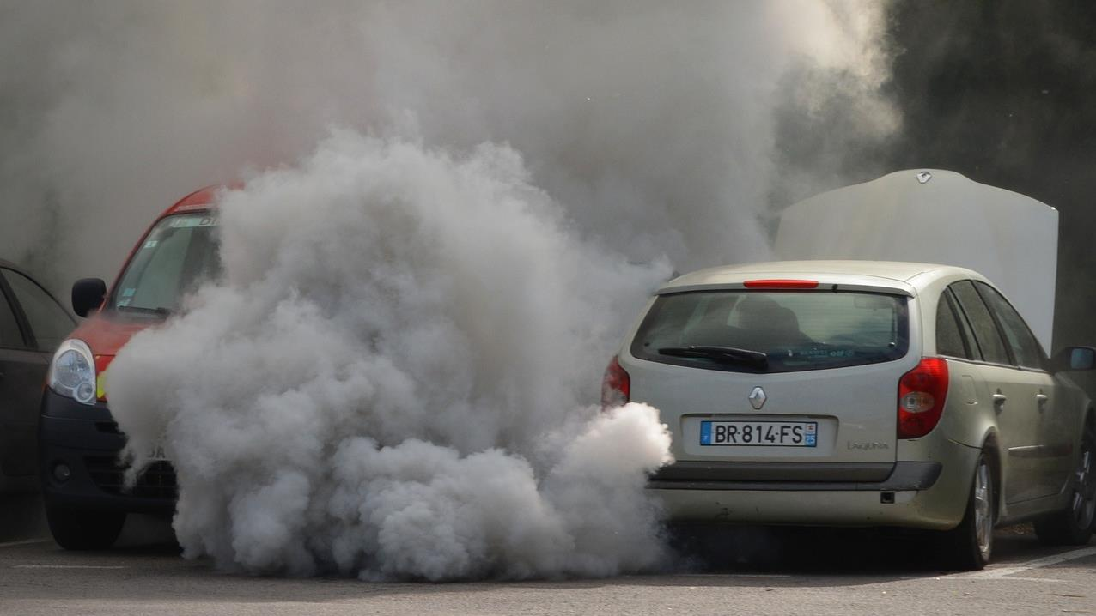
What is air pollution?
Tiny Particles
Harmful Gases

Slide 10
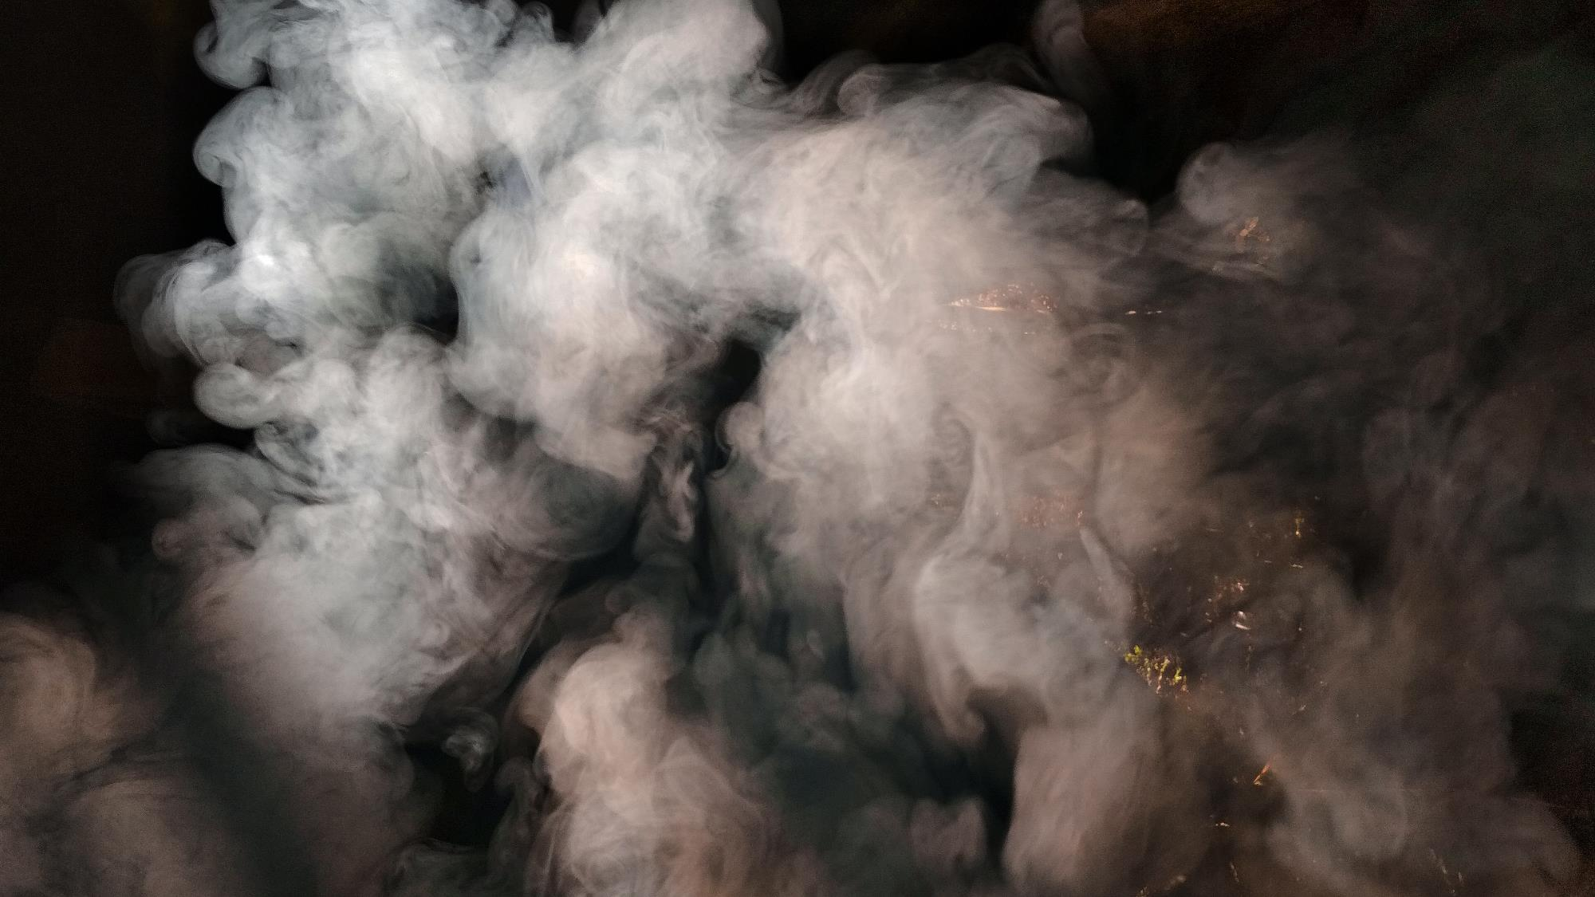
Harmful Gases
N
O
O
O
O
O
S
Nitrogen Dioxide (NO₂)
Ozone (O₃)
O
O
Sulphur Dioxide (SO₂)

Slide 11

Tiny Particles
Anything solid or liquid suspended in air
Combustion by-products
Ash
Fumes
Soot
Tar
Volatile organic compounds
Man-made materials
Metal dust
Flour
Aerosols
Volatile liquids
Natural particles
Dust
Pollen
Spores
Sea salt
Watch Video – good and bad particles https://www.youtube.com/watch?v=_8RI6KZ9R_g

Slide 12

Tiny Particles
The size is more important than the source
Human hair
50-70 micrometers
PM10
Particles less than 10 micrometers across
PM2.5
Particles less than 10 micrometers across

Slide 13
PM10 particles can reach the upper airways, causing inflammation and damage
PM2.5 particles can reach the alveoli and even diffuse into the bloodstream, causing more serious problems

Slide 14
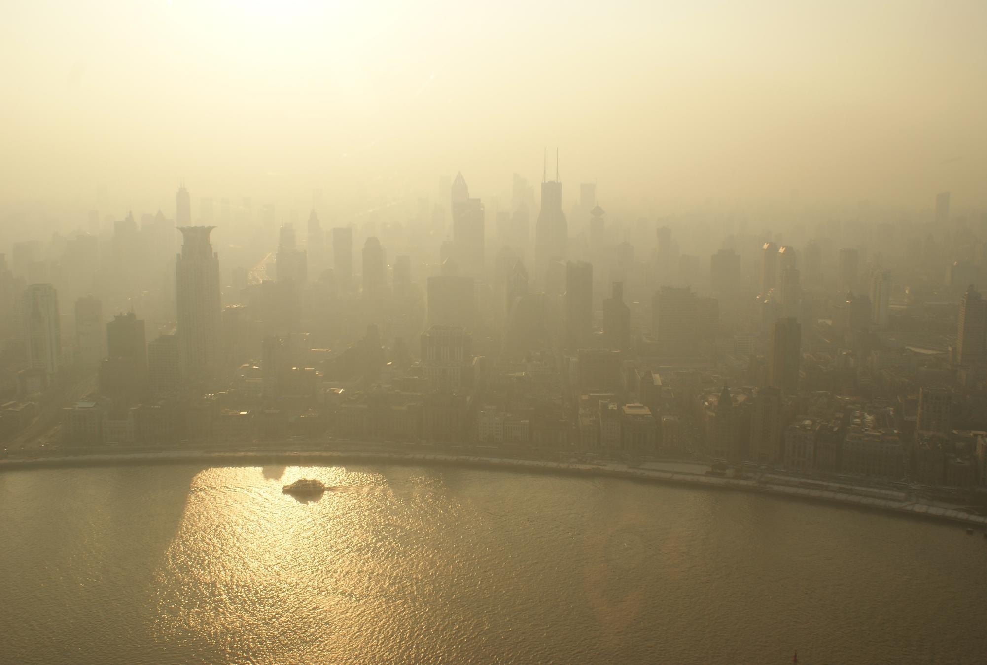
Where does air pollution come from?

Slide 15
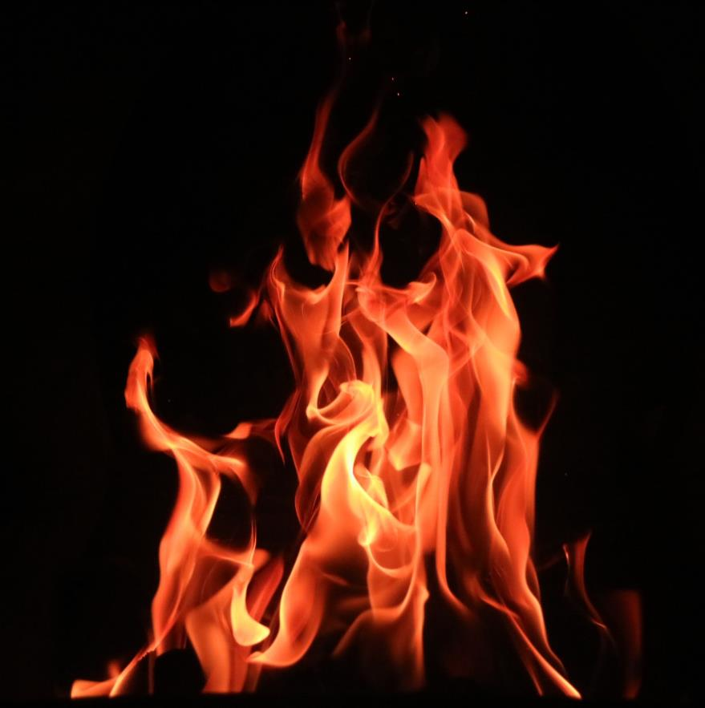
Where does air pollution come from?
Most air pollution comes from burning stuff including…
Coal
Gas
Petrol and Diesel
Jet Fuel
Wood
Paper

Slide 16

So where do the particles come from?
Ceramic tile
What is this?
Candle or Bunsen burner
Can’t do the demo?
Watch the video instead

Slide 17
Complete and incomplete combustion
Complete combustion
hydrocarbon + oxygen → carbon dioxide + water
Particles
Incomplete combustion
hydrocarbon + oxygen → carbon dioxide + water + carbon monoxide + carbon

Slide 18
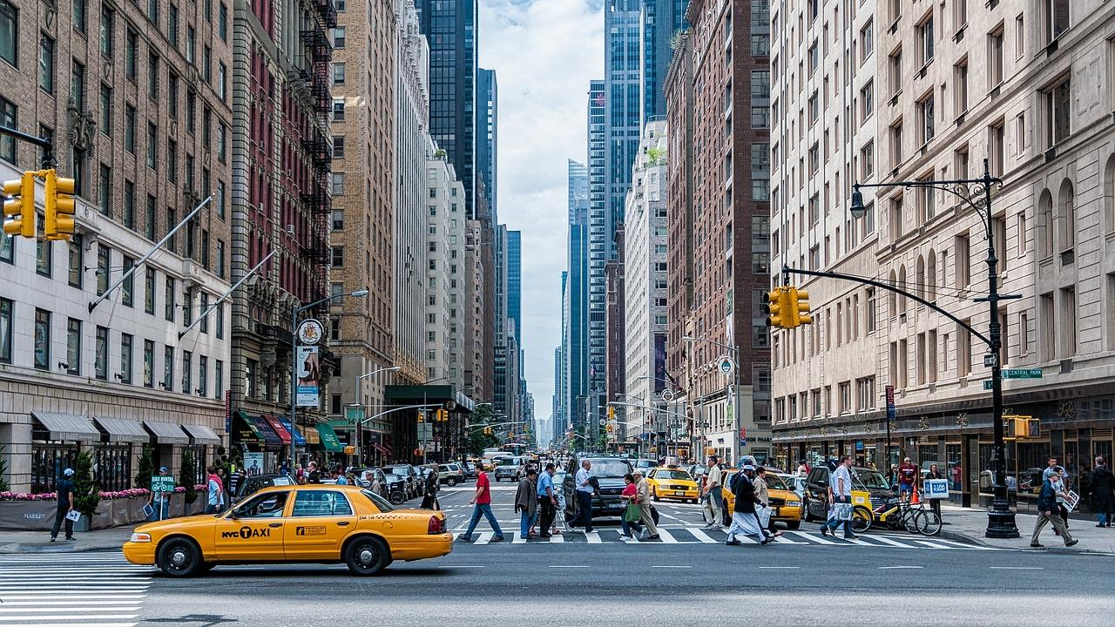
Can you identify sources of air pollution?

Slide 19


















Fires | Buses/Trains | Petrol/diesel cars | Smoking | Aerosols | Cycling
Solar panels | Farming | Volcanos | Electric cars | Fireworks | Walking
Cleaning products | Power stations | Trees | Aeroplanes | Wind turbines | Motorcycles

Slide 20
Are all the sources of air pollution equally bad?
What can we do to reduce air pollution?

Slide 21
Fill in the worksheet
Causes (where air pollution comes from) | Effects (how air pollution affects people and places) | Solutions (what we can do to make things better)

Slide 22
True or false?
Air pollution affects children more than adults
TRUE!
Childrens lungs are more vulnerable as they are smaller and still developing. They also breathe faster so may take in more pollutants.

Slide 23
True or false?
You can always smell air pollution
FALSE!
Some air pollutants, like car exhausts, have a strong smell but others are completely odourless

Slide 24
True or false?
Air pollution only affects our lungs
FALSE!
Air pollution can also affect the heart/ circulatory system and the brain/nervous system

Slide 25
True or false?
Sometimes air pollution is invisible
TRUE!
Some of the most dangerous air pollutants are incredibly tiny particles which can go deep into the lungs and get into the bloodstream

Slide 26
True or false?
All air pollution is made by humans
FALSE!
Natural sources of air pollution include wildfires, volcanoes, and dust storms. Mould spores and pollen can also aggravate lung problems.

Slide 27
True or false?
Air pollution is often worse on hot sunny days
TRUE!
The sunlight can trigger chemical changes which make the pollutants even more dangerous.

Slide 28
True or false?
Air pollution is always worst outdoors
FALSE!
Air pollution can much more concentrated inside buildings and cars. The air is more still so pollution builds up.

Slide 29
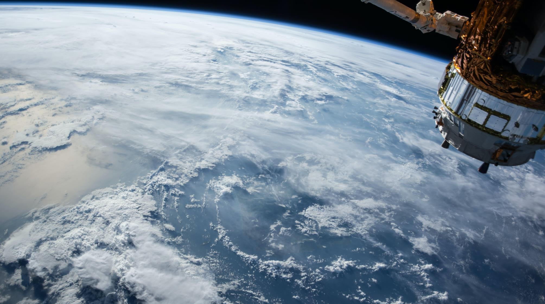
Looking at air pollution data

Slide 30
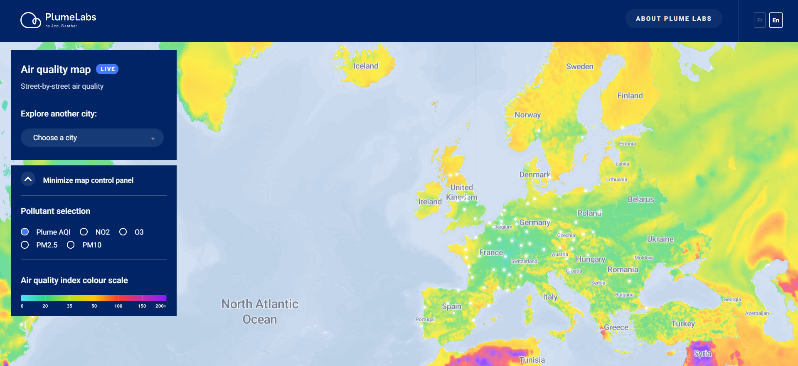
https://air.plumelabs.com/air-quality-map

Slide 31
Looking at air pollution data
Place | Overall air quality (AQI) | NO₂ | O₃ | PM2.5 | PM10
Do you notice anything interesting about what you have found out?

Slide 32
Make your clean air pledge
#BreatheCleanAir
I want to breathe clean air. I will do my bit to reduce air pollution. I promise that I will….

Slide 33
Ideas for action
Don’t smoke or vape
Go outside
more
Avoid using spray deodorant
Walk on quieter roads or through parks
Car share with friends
Turn car engine off when waiting
Use public transport more
Walk, scoot or cycle to school
Ask family not to use an open fire
Wear a face mask when doing crafts
Open the windows more often

Slide 34


