Slide 1



Smoking and vaping
Age 11-14 (UK Key Stage 3)

Slide 2
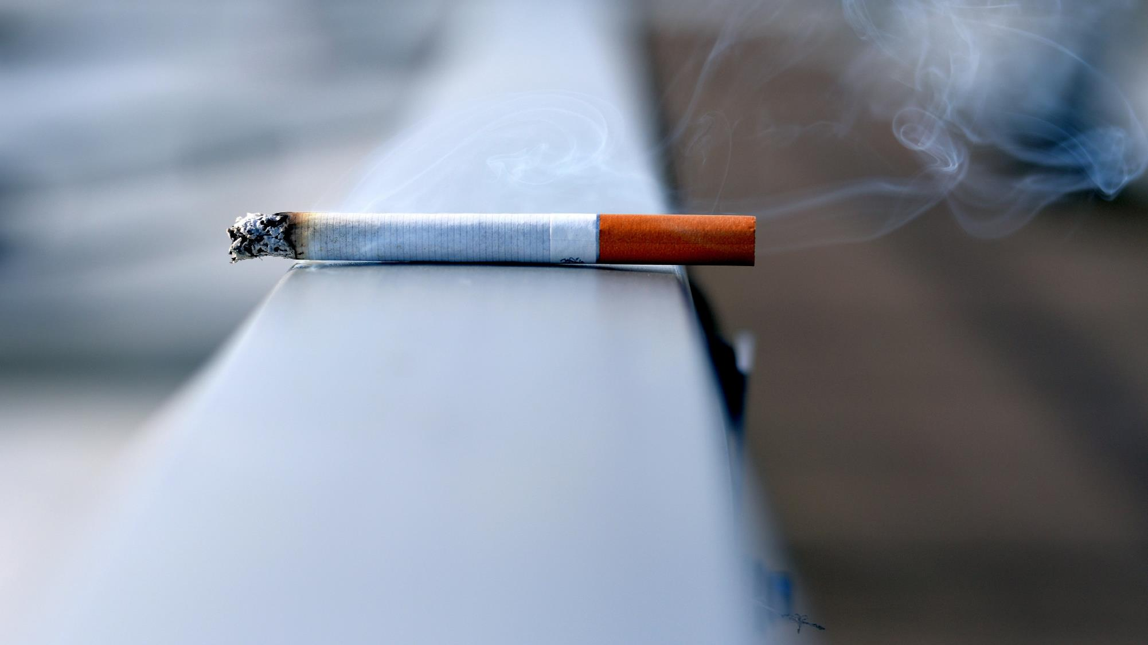
What is smoking?

Slide 3


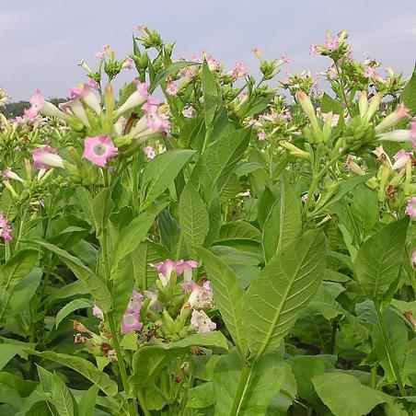
Cigarettes
Burning tobacco makes smoke which is inhaled
The smokes contains nicotine, a very addictive drug
The smoke also contains tar, carbon monoxide and other toxic chemicals
Cigarettes contain dried leaves of the tobacco plant

Slide 4
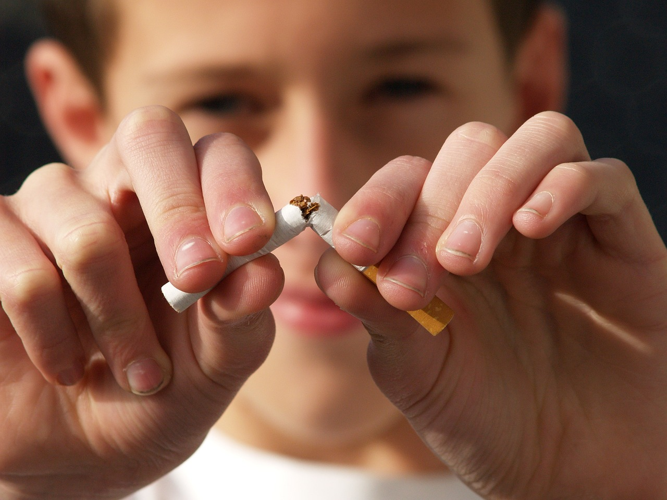
Why is smoking such a big problem?

Slide 5


Smoking can…
Cause lung and heart disease, cancer, and many other health problems
Lead to early death

Slide 6
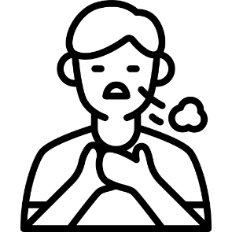

Smoking can…
Make non-smokers ill if they are nearby and breath in the smoke
Be very addictive – once you start it is very hard to stop

Slide 7
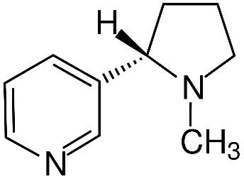

Smoke contains
Nicotine
Tar
O
Carbon monoxide
C
Over 4000 other chemicals

Slide 8

How smoking affects the body

Slide 9
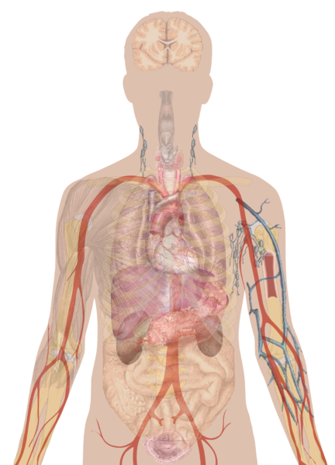


Smoking affects every part of the body
Brain: addiction, stroke, anxiety
Mouth: gum disease, bad breath, loss of taste/smell
Eyes: blindness, cataracts
Lungs: cancer, COPD, bronchitis, pneumonia, emphysema
Heart: heart disease, heart attack
Cancer anywhere in the body
Blood: high blood pressure, poor circulation
Watch a video on how smoking affects the body https://www.ted.com/talks/krishna_sudhir_how_do_cigarettes_affect_the_body?language=en
Genitals: infertility, pregnancy problems

Slide 10

How smoking affects the lungs

Slide 11
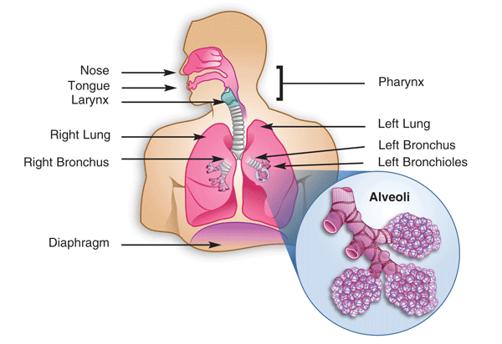
How the lungs work
Watch an animation of how the lungs work https://www.youtube.com/watch?v=f_xnopMf3p8

Slide 12
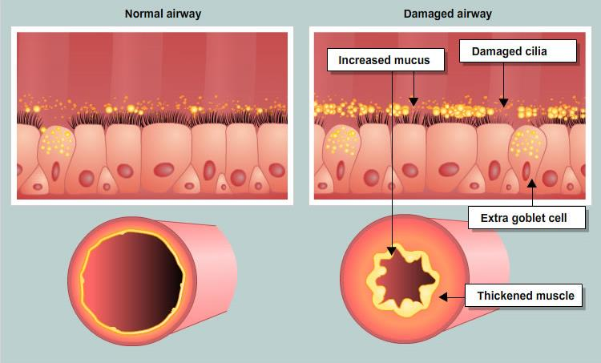
How smoking affects the lungs
Healthy Lungs
Goblet cells make mucus which traps dirt and pathogens
Tiny hair-like cilia sweep mucus out of the lungs
The airways are open and relaxed
Most viruses and bacteria are trapped and cleared so fewer infections
Smokers’ Lungs
Tar and smoke damages the cilia
Mucus builds up
The airways narrow
It’s harder to breath
Cough more to clear mucus
More likely to get colds, flu and chest infections
Watch a demo using real lungs https://youtu.be/uirINayrSJs?si=GStZDfGqoOxQJEpA

Slide 13

Asthma and COPD
Asthma and COPD are lung conditions that can make it hard to breathe
Asthma is often inherited (genetic) but smoking makes it worse
COPD is almost always caused by smoking
Do you or anyone you know have asthma or COPD?

Slide 14
Why COPD makes it hard to breathe
Try breathing through a straw to see what it feels like to have COPD
Healthy airways are relaxed and open so air can flow easily
With COPD the airways get swollen, making it hard to breathe
Smoking causes this

Slide 15
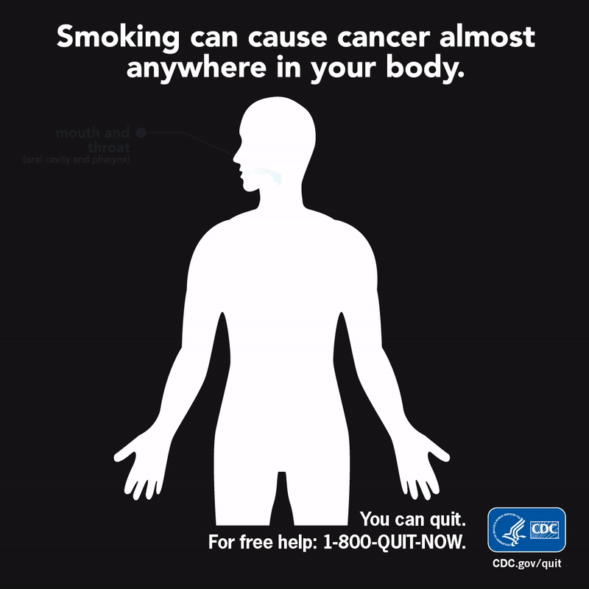
Lung Cancer
Cancer is a disease where abnormal cells grow uncontrollably
Smokers are 25 times more likely to get lung cancer than a non-smoker
Smoking also increases the risk of developing many other kinds of cancer

Slide 16
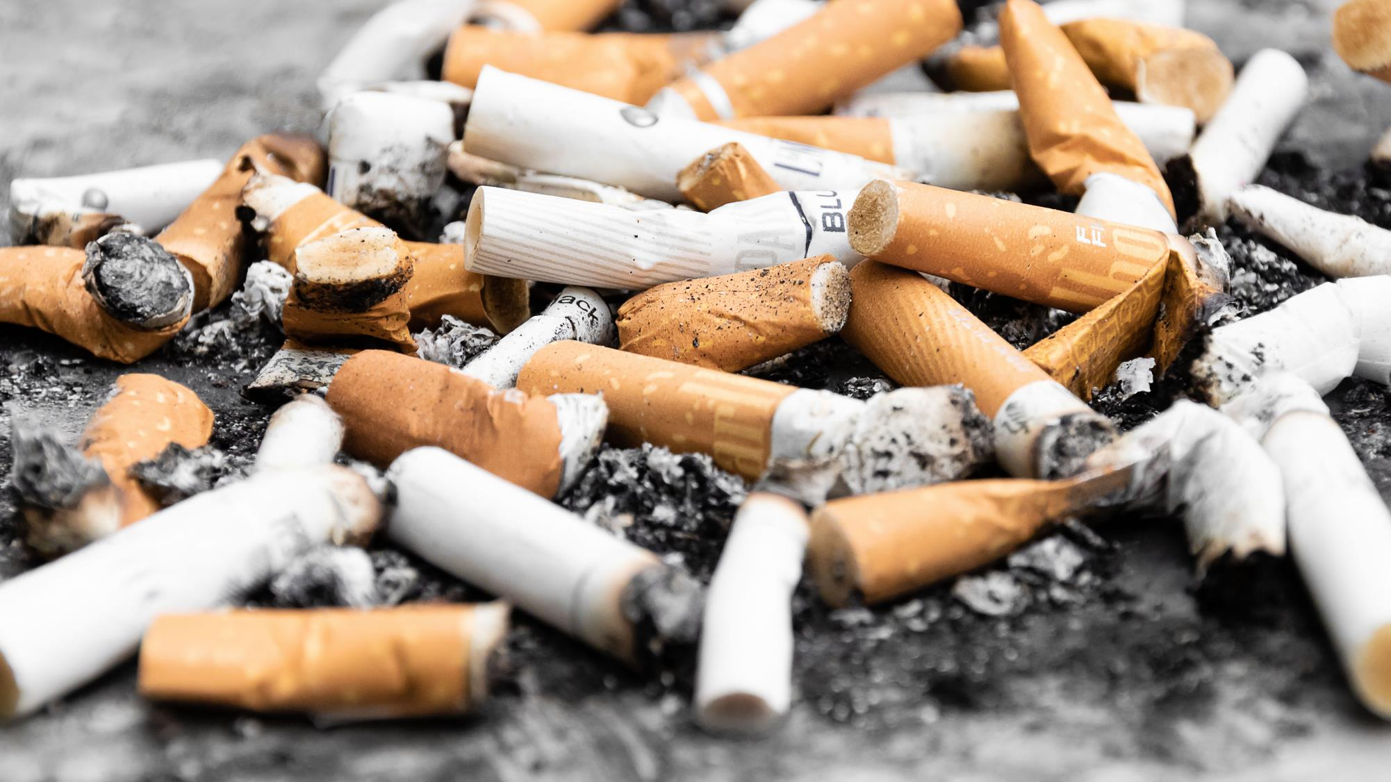
The risks of smoking

Slide 17




Understanding risk
Risk = how likely something is to happen x how bad it could be
 | Dying in a plane crash | Being in a car accident | Rolling two sixes | Catching a cold
How likely is an accident? | Very unlikely | Moderately likely | Moderately likely | Very likely
If it happened how bad would it probably be? | Very serious | Quite serious | Not serious at all | Not usually serious

Slide 18




Very serious
Dying in a plane crash
Very serious
Very unlikely
High risk
Being in a car crash
Quite serious
Moderately likely
Rolling two 6 dice
Not serious at all
Moderately likely
Low risk
Catching a cold
Not usually serious
Very likely
Not serious
Very unlikely
Very likely

Slide 19
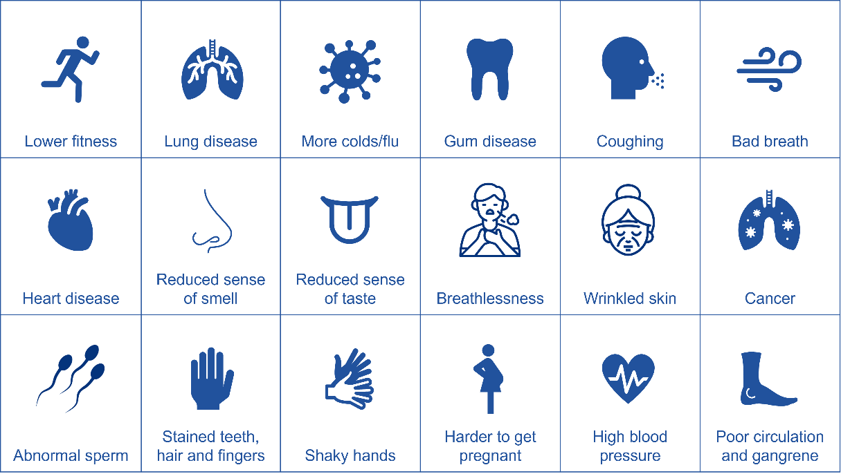
The risks of smoking
Look at the health effect cards. Can you…?
Sort the cards from most serious to least serious
Sort the cards from most likely to least likely
Can you use your rankings to place the risks on the chart?
(NB there is no definitive right or wrong answer)

Slide 20








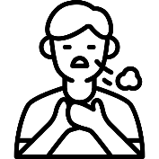








Lower fitness | Lung disease | More colds/flu | Gum disease | Coughing | Bad breath
Heart disease | Reduced sense of smell | Reduced sense of taste | Breathlessness | Wrinkled skin | Cancer
Abnormal sperm | Stained teeth, hair and fingers | Shaky hands | Harder to get pregnant | High blood pressure | Poor circulation and gangrene

Slide 21
Rate the health effects of smoking
Very serious
Heart attack/stroke
Lung cancer
Chronic lung disease
Other cancers
Fertility problems
Loss of smell/taste
Stained teeth/fingers/hair
Wrinkles
Bad breath
Gum disease
Not serious
Very unlikely
Very likely

Slide 22
Which health effects of smoking do you think are the worst?
Which health effects would convince you to stop or not start?

Slide 23
Quitting quickly and dramatically reduces the health risks of smoking

Slide 24

What is passive smoking?

Slide 25
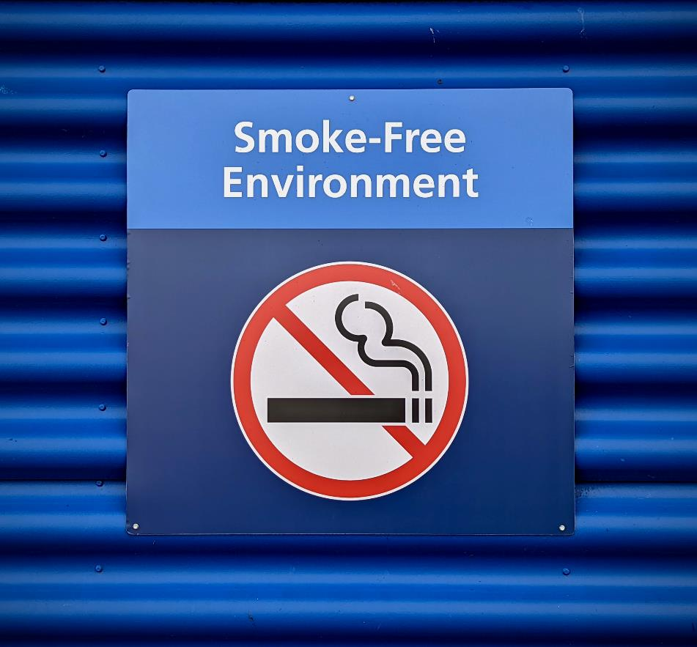
Passive smoking
Passive smoking means accidentally breathing in smoke from someone else’s cigarette
It can cause the same health effects as smoking.
Children are particularly at risk.
This is why smoking is banned in public places in many countries.

Slide 26
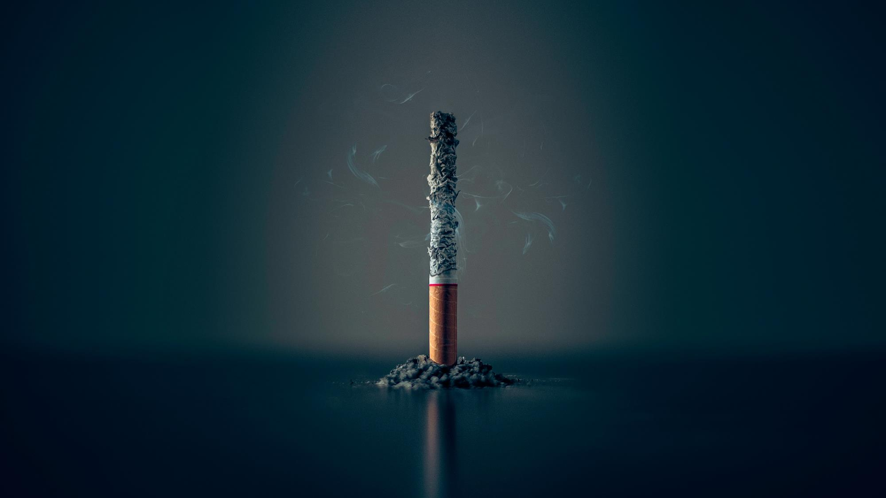
What regulations protect people from passive smoking in your country?
What behaviours can reduce your exposure to passive smoke?

Slide 27
True or false?
Smoking only affects the lungs
FALSE!
Smoking affects almost every part of the body, and more smokers die of heart disease than lung cancer.

Slide 28
True or false?
More than half of smokers die will from smoking
TRUE!
Some studies have found up to two thirds of long-term smokers die of a smoking-related illness.

Slide 29
True or false?
Nicotine is the most dangerous thing in cigarettes
FALSE!
Although nicotine is very addictive, the tar and carbon monoxide in smoke cause the most damage

Slide 30
True or false?
Smoking or vaping can trigger asthma attacks
TRUE!
Asthma is mainly genetic, but smoking, passive smoking or vaping can trigger a life-threatening asthma attack

Slide 31
True or false?
There’s no point in quitting as the damage is done
FALSE!
Within just a few days the body can start to repair itself. Within a few years an ex-smoker will dramatically reduce their risk of illness.

Slide 32
True or false?
Smokers die 5 years earlier than non-smokers
FALSE!
It’s even more!
Typically, lifelong smokers die 10 years earlier than non-smokers.

Slide 33
True or false?
Smoking in pregnancy harms the baby
TRUE!
Cigarettes reduce oxygen to the baby and there is a higher chance of the baby being premature or stillborn.

Slide 34
True or false?
Vaping is safe
FALSE!
It’s probably less dangerous than smoking but can be just as addictive. There is increasing evidence it causes lung damage.

Slide 35

Smoking v Vaping

Slide 36

E-Cigarettes / Vapes
A battery heats the liquid to produce vapour which is inhaled
Like in cigarettes, nicotine is addictive
Vapes contain a carrier liquid, nicotine and flavouring
The hot vapour can irritate the lungs

Slide 37

Why is vaping a problem?
Vapes were invented to help people stop smoking
Vapes haven’t been around long enough for us to understand the long-term health effects
People who were never smokers (especially young people) are starting to vape
Young people are getting addicted to nicotine

Slide 38
Health effects of vaping
Addiction
Anxiety
Memory problems
Sleep problems
Possible link to gum disease
Lung damage
Chronic cough
Asthma attacks
More likely to start smoking due to nicotine addiction
Exposure to potentially harmful chemicals
Don’t know what long-term effects might be

Slide 39
Why vaping is particularly risky for teens
Teen lungs are still developing so are more easily damaged
Teen brains are still developing so get addicted more easily
The earlier you start and the longer you vape, the more likely it will lead to health problems
Getting addicted to nicotine early can make smoking more likely later

Slide 40
Smoking v Vaping
 | Smoking (cigarettes) | Vaping (e-cigarettes)
What it is
What it contains
Laws
Health effects

Slide 41


